Slide 1
LOSELEY FIELDS
PRIMARY SCHOOL
NEWSLETTER
SEPTEMBER 2024
A word from the Headteacher
What a wonderful start to our new academic year here at Loseley. Thank you to all our parents for sending the children back to school in smart school uniform for the start of the academic year; I am always so proud to see how well they have turned out with their smart newly polished shoes.
It has been particularly lovely to welcome so many new families to our school this year. We all look forward to sharing the next seven years with you and your family as your children travel through our wonderful school, growing and developing as young learners along the way. Our new Reception children have settled remarkably well into the new routines of school. They are now keenly taking part in their daily phonics lessons and it won’t be long until you get to experience that remarkable joy when they understand that the print in books makes stories that they can read.
Our school Buddy System is also underway with our Year 6 children supporting our Year 3 children with their transition into the junior part of the school. These year groups all enjoyed a ‘Buddy’ afternoon together this week undertaking team building challenges and ‘getting to know you’ activities. This will soon be rolled out to our Year 3 children who will be buddied with our new Year R children so they have an older pupil to support and inspire them whilst at Loseley. Student leadership is an important element of the work that we do whilst your children are at school, teaching them how to take responsibility as active members of our school and community.
Our Autumn Term curriculum delivery is now well under way and by now our year group welcome letters for parents will be coming your way via Parentmail. Please take time to review these letter as they explain what your child will be learning in school along with practicalities such as days that they need their PE kits in school.
Kind regards,
Amanda Pedder – Executive Headteacher
Our Values - Pupil achievement
A reminder for new parents:
Across the year we actively celebrate the children who can demonstrate the school values at school or at home. Please watch out for special citizenship tasks on the home learning grids which gives your child the opportunity of practicing the values with you at home. If you can support us by using this language at home and celebrating these values at home then that will really support us at school.

Slide 2
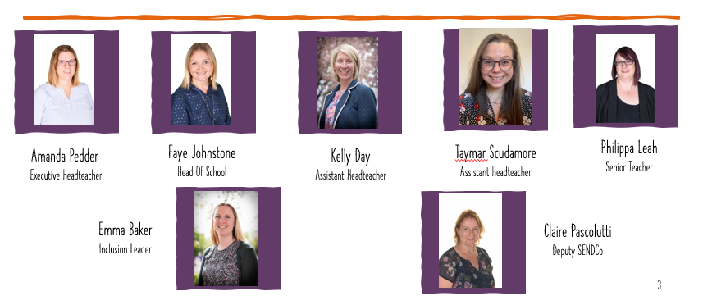
SEPTEMBER, 2024
Meet the LEADERSHIP TEAM:
I thought that it would be helpful to introduce the wider leadership team to you all now that our partnership working with Farncombe Infants School is well underway so that you are aware of all our new roles in case you want help and support with anything across the year.
My role as Executive Head means that I am responsible for the strategic direction of both Loseley and Farncombe over the next two years. I spend time across the week in each school so that all the parents, children and staff know me well but with Loseley being the bigger school, the majority of my time is spent here at Loseley.
Mrs Johnstone is Head of School. She is responsible for the day to day running and operations at Loseley. She carries many important responsibilities but in particular leads on safeguarding, standards and outcomes and teaching and learning
We now have two Assistant Headteachers who support Mrs Johnstone and myself to deliver the strategic aims of the school. Each carry unique responsibilities. Miss Scudamore, is responsible for Early Year Education and Pupil Premium and Mrs Day is responsible for Key Stage One education and Maths.
Our Inclusion Team is led by Mrs Baker who is our Inclusion Leader. She is the school SENDCo but also leads on Attendance and staff well-being. She is supported by Mrs Pascolutti who is our Deputy SENDCo who supports on whole school SEND as well particularly supporting the children and families who attend Leo class, specialist centre.
Miss Leah is a Senior Teacher. She supports KS2 education, the curriculum and English.
Upcoming Whole school events
Term dates
Follow us
Loseley Fields
Primary School
@LoseleyFields
@loseleyfields
Wednesday 9th October – E-Safety Day
Wednesday 16th October – Open Evening (Prospective Parents) Friday 25th October – Inset Day Monday 4th November – Inset day
Autumn Term
2nd Sept – 25th Oct Half term – 28th Oct – 1st Nov 4th Nov – 20 Dec Christmas – 21 Dec – 5th Jan

