Slide 1



LOSELEY FIELDS
PRIMARY SCHOOL
NEWSLETTER
OCTOBER 2024
A word from the Headteacher
Dear Parents/ Carers
As we approach our half term holiday, we are starting to see a noticeable shift in the seasons with darker mornings, leaves falling from the trees and crisp early mornings. I am sure many of you will enjoy making plans for the half term break to carve a pumpkin with your child and will be identifying what fireworks display you might attend; it is always such a popular time of year with young children.
We enjoyed welcoming prospective new parents into school last week for our Open Evening and parent tours to see our school in action. We have more tours booked in for after half term. This is such an important part of our school calendar, and it always brings me great joy to open our wonderful school to new families – it brings me such joy to be able to show others the amazing learning environments that the teachers and teaching assistants create for our children every day and for them to see just how well our children behave at school. There is always such purpose but also joy around the school each day.
This week has been our Reading Festival at school giving opportunities to celebrate a real love of reading across our adult and pupil groups. Thank you to all the parents that attended our reading cafes earlier in the week. It was world, to see so many parents all the way up to Year 6 take the time to come and read in school, showing our children that we can all enjoy a good book too! It is so important to model this to our children. We have had book Oscars, visits from real authors and many opportunities for the children to buy books and engage with high quality literature. Thanks to The Friends who funded some of these invaluable opportunities world, a massive thank you the Miss Leah for organising such a fabulous week.
It was lovely to welcome Sharon Girling to Loseley a couple of weeks ago. She founded CEOP, the government organisation who tackle online child abuse, as well as wrote many of the early government policies relating to the internet. She worked with children in Years 1 to 6 as well as staff and parents. During her parent workshops, she explored many of the current apps available and how parents can best support their children to be safe in online spaces. Sharon said we don’t let our children out and about on a dark evening on their own and we have to see the online world in the same way. We have to support them to navigate it but with the boundaries we put in place as ultimately keeping our children safe is our responsibility. Parents who attended the workshop were extremely positive about the session and had some practical examples of how we can set parental controls as well as how to talk to our children about their use of devices. Some key takeaways:
This is not about taking devices and closing down conversations. We want our children to talk to us about what they are doing, if something makes them uncomfortable and sharing what we can do if something goes wrong online. A culture of taking devices away can lead children to be more secretive which does not enable us to have open conversations and safeguard them.
Setting up tablets can go beyond just the apps that are downloaded but we can remove the camera icon, remove wireless capability as well as not save the account with their real name and birthday.
Age restrictions matter- each app or game will have their own set of terms which we need to understand. For example, WhatsApp can be used by children 13 years or older. Registering an account on behalf of someone who does not meet the minimum age requirements is a violation of WhatsApp’s Terms as well as creating an account with false information (even if this is done by the child). This violation of terms stops users being protected and places the responsibility on them if something goes wrong.
We live in an ever-changing digital world, and we want to work with our parents and carers on how we can best support our children in staying safe online. Here is a quiz that is meant to support discussions between parents/carers and their children about online safety but have a go yourself! https://www.nspcc.org.uk/keeping-children-safe/online-safety/quiz/ For more information regarding age ratings, please see https://saferinternet.org.uk/guide-and-resource/how-are-age-ratings-for-apps-and-games-rated
Wishing you all a lovely holiday.
Kind regards,
Amanda Pedder – Executive Headteacher

Slide 2
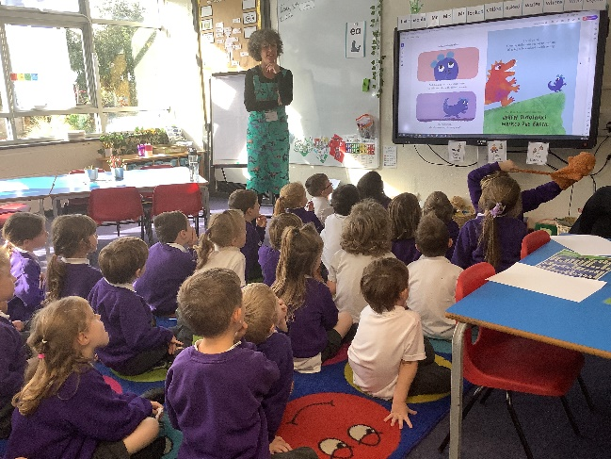
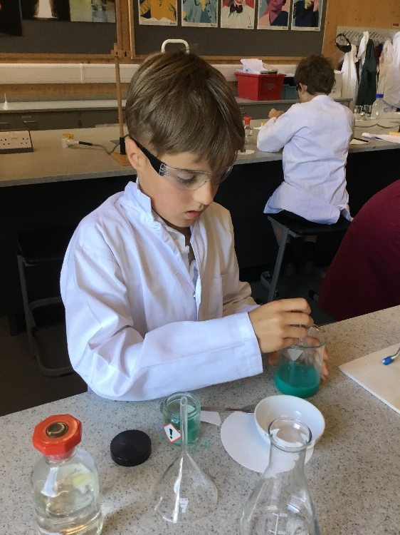
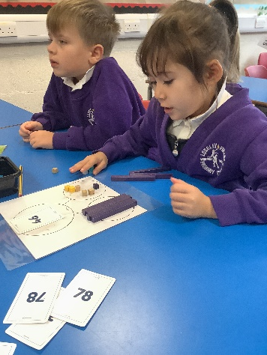
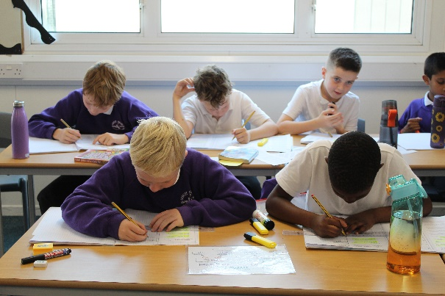
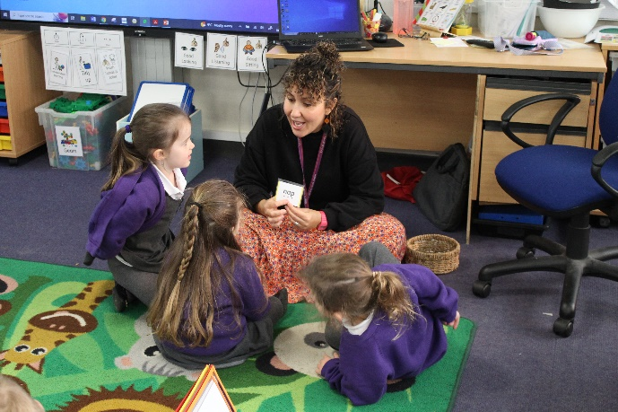
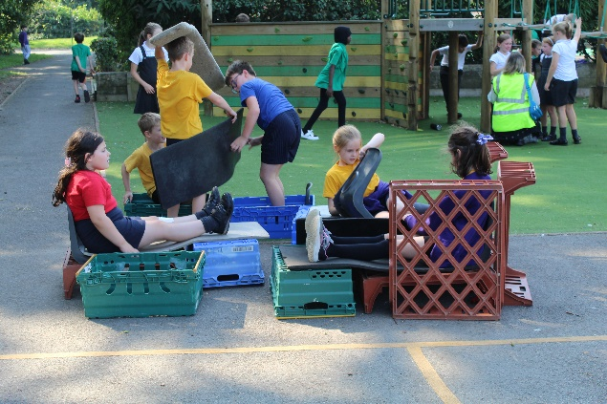
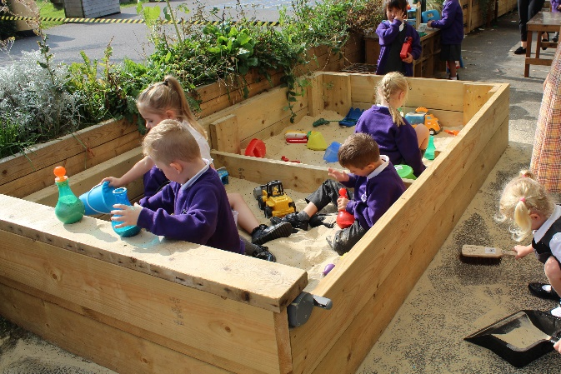
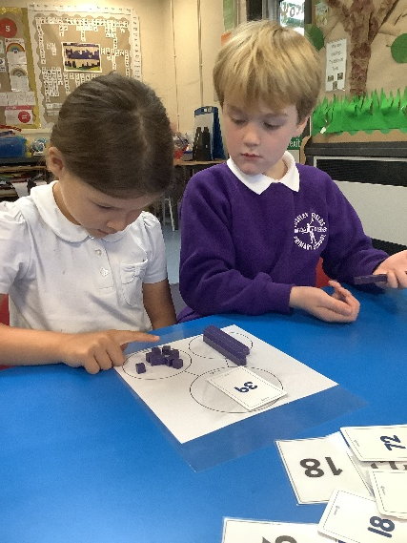
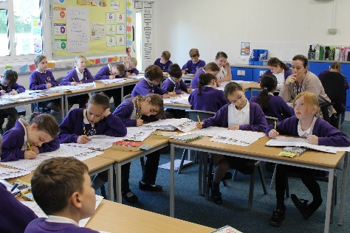
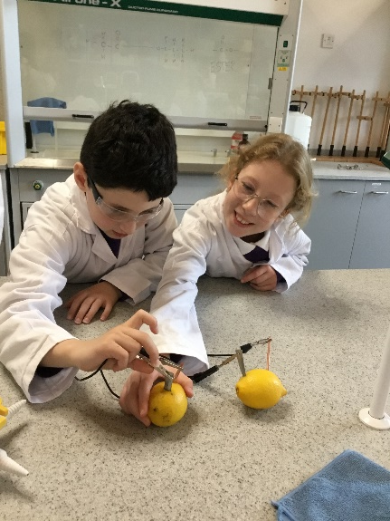
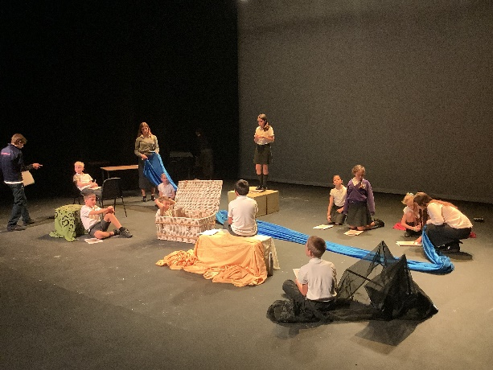
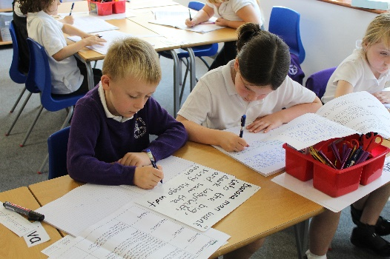



Our children’s learning in action
OCTOBER, 2024
Loseley Fields
Primary School
@loseleyfields
@loseleyfields

