Slide 1
LOSELEY FIELDS
PRIMARY SCHOOL
NEWSLETTER
DECEMBER 2024
A word from the Headteacher
Dear Parents and Carers,
December is such a magical time of year in a primary school. The anticipation that builds up across these remaining weeks of term is tangible with so many special memories created as we hurtle towards Christmas day. Christmas is all about traditions. You will know from your own family homes the traditions you create around this special time are probably similar to those you had as a child and will also probably be what your child does in their homes when they become adults and parents in the future. These special memories created are rarely about the presents; the things your children will remember and pass on are the little, but very important details. My daughter, who is now very close to the teenage years said to me at the weekend as we put up the decorations, ‘Mum, this is the best time of year. I love this more than my birthday because it is about family, being together, celebrating and playing games.’ In our house, the build up to Christmas is almost more magical than the day itself. In my home we have certain traditions that we have always done since my daughter was first born. Each year we visit a garden centre and she chooses a new bauble to put onto the Christmas Tree. Each bauble represents another year passed and another year full of memories of the things we have done together across the year. Every year when we get the box of decorations from the loft, she carefully unwraps each bauble and she remembers each one in turn, recalling the stories of why she chose that one with excitement. It’s a small thing that costs me only a few pounds each year, but it is a tradition which I know that she will pass on to her children with the same joy that it has brought us. Each year we also spend one weekend doing the Christmas baking. We make sausage rolls, decorated Christmas biscuits and cheese straws. My daughter would now not allow me to buys these from a shop. The years have passed and the tradition has become embedded – its just what we do now and Christmas just wouldn’t be Christmas without these events taking place.
As we approach this festive season, maybe focus on the personal traditions you have at home. Make sure your child understands why these small things are so important and the value they bring you all at home. It really doesn’t matter what they are, what is important is the fact that you do them together – it is the togetherness and family moments that the children will remember forever. Share them with us here at school so that we can all remember the true meaning of Christmas in a world full of commercialised pressure.
At school we shape memories through our school Christmas traditions of the snowflake ball, the noisy Christmas dinner, our naughty visits from Elvis the Elf, the infants Christmas nativity and our end of year Christmas sing-a-long assembly. We have many other exciting calendar events ahead so keep a close eye on Parentmail communications.
Wishing you a magical Christmas when it comes.
Kind regards,
Amanda Pedder – Executive Headteacher
Our Values - Pupil achievement
How have your children demonstrated our values at home or in their life outside school
This month we have been celebrating children’s achievements outside of the school environment. In particular, we have enjoyed learning about children who have been learning musical instruments outside of school and who have successfully practiced piano pieces for a winter concert. In addition, we have celebrated other sporting achievements in rugby, karate and dancing. If your child works hard to achieve goals outside of school learning please let Mrs Baker know so we can celebrate it in our Monday assemblies?

Slide 2
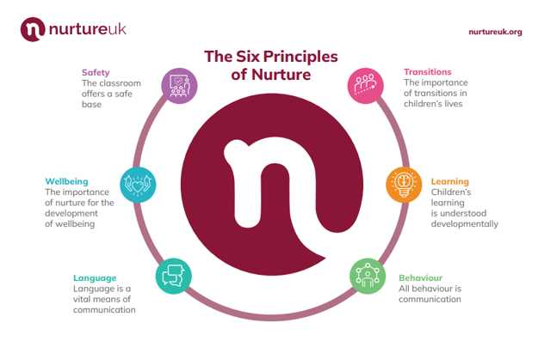
DECEMBER, 2024
Meet the INCLUSION LEADER
Upcoming Whole school events
Term dates
Follow us
Loseley Fields
Primary School
@LoseleyFields
@loseleyfields
Wednesday 18th December – Christmas Lunch
Wednesday 18th December – Christmas Jumper Day
Friday 20th December – Last Day of Term 1pm Finish
Friday 20th December – Last Day of term 1pm Finish
Monday 6th January – Start of Spring Term
Wednesday 29th January 2025 – Inset Day
Monday 17th – 21st February – Half Term

